Slide 1
Week CIS 215
Ethics

Slide 2

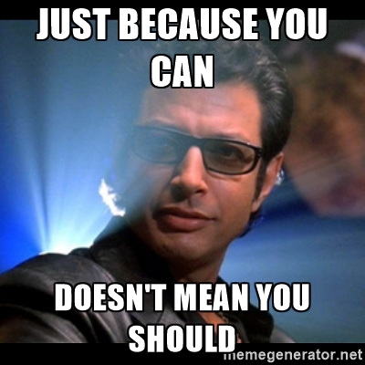
What is Ethics?
According to the Oxford English Dictionary
Ethics is "moral principles that govern a person's behavior or the conducting of an activity."
Dr. Ian Malcolm, played by Jeff Goldblum, as he declared, “Your scientists were so preoccupied with whether they could, they didn’t stop to think if they should.”

Slide 3
Why do we talk about Ethics in Computer Security?
Ethics and the law is not the same thing
Most people that make the laws, seriously lack technical expertise
https://www.cnet.com/news/politics/some-senators-in-congress-capitol-hill-just-dont-get-facebook-and-mark-zuckerberg/
Technology and cybersecurity are a huge part of our everyday lives now. Technology was created by humans, and therefore will have a bias, technology isn't neutral.
A select few can have a huge impact on many people, if people don't design and protect systems with ethics in mind we widen already unfair social arrangements.

Slide 4
Example: Common ethical challenge in Computer Security
Who can test for safety? If you are creating a medical device, say an insulin pump, what testing should happen? Who should do that testing? Is it required? How much money is "too much" for testing?
https://www.sciencedirect.com/science/article/pii/S2468067222001201
Equifax, why your credit score matters and who is in charge of it. What your credit score is used for whether you know it or not. Private companies vs Governments
https://www.ftc.gov/enforcement/refunds/equifax-data-breach-settlement
Data disclosure, If you work in IT you're likely to see sensitive data such as emails, proprietary information, and personal devices. Think about Edward Snowden and the situation he was in.
https://www.cnbc.com/2019/11/04/edward-snowden-warns-about-data-collection-surveillance-at-web-summit.html

Slide 5
Computer Security and Ethics Discussion
Voting: should we have Electronic voting? Vote by app? Vote by mail? Electronic booths you have to go to in person? How are each of those secured and taken care of (updates and also watched when it's not voting time?)
Farming: Should farmers be able to service their own tractors? If they break them are they still under warrantee? What obligations does a company have to make the products easy to service vs secure? What is the line between company profits and ethics?
Device data: Many things have Wi-Fi and cameras now such as dolls and vacuums, at what point should we be worried about recordings or pictures being taken? What is considered "private" now? What expectations of privacy do you have in your home?

Slide 6
Ethics Best Practices
Ethics and Laws are not the same, laws change slowly, just because you can do something, doesn't mean you should.
Keep in mind everything has a cost, and there could be lives at risk
Just because you have ethics, doesn't mean everyone does, keep in mind that when you make something and make it public, anyone can use it, there is no test of morals to get on the internet.
Think about how information is shared, does this information need to be collected? What's the worst case scenario if it's lost/taken/shared?
Think about others, other people, other situations, and remember not everyone has all your privileges.

